Slide 1
Banking Today

Slide 2
What does M1 represent?
M1 represents money that people an gain access to easily and immediately to pay for goods and services.
Liquidity – The ability to be used as, or directly converted to cash

Slide 3
What is M2?
M2 can not be used as cash directly but can be converted to cash easily.
M2 assets are also called near money.
Money in your savings account would be considered M2. You can’t hand the cashier your bank statement, but you could go to an ATM.

Slide 4
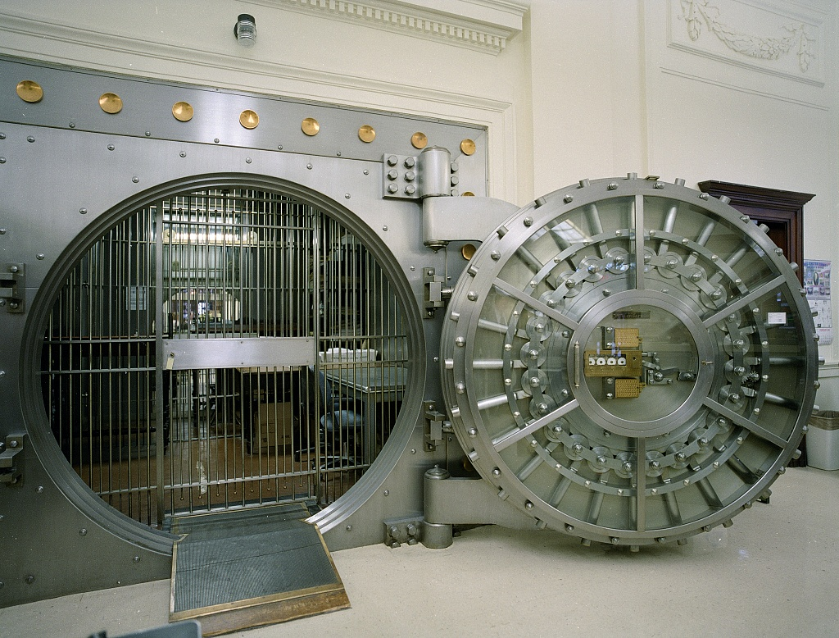
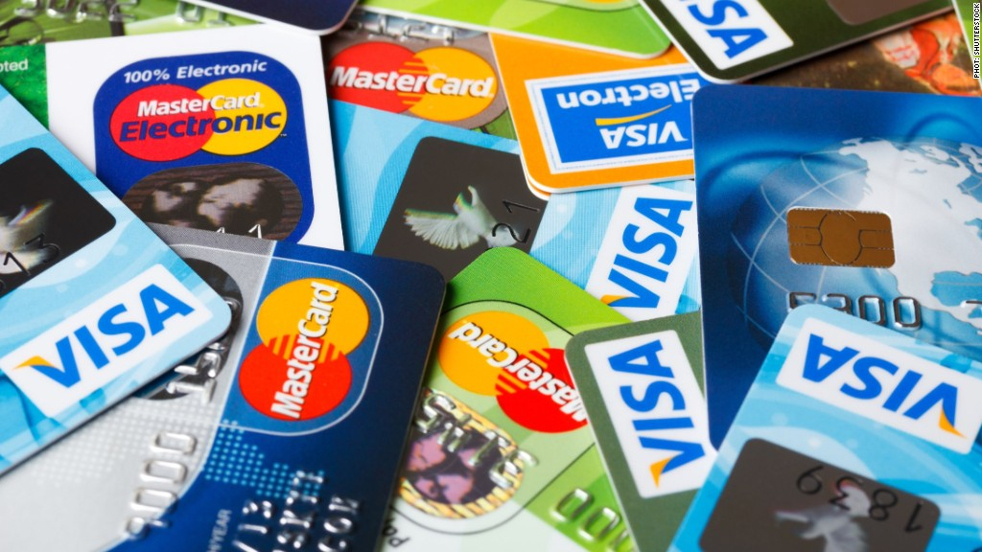
What are 3 services a bank offers?
Storing/Saving Money
Loans
Mortgages
Credit Cards

Slide 5
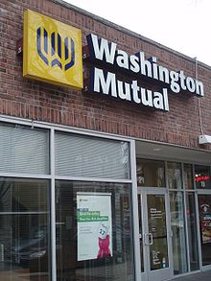
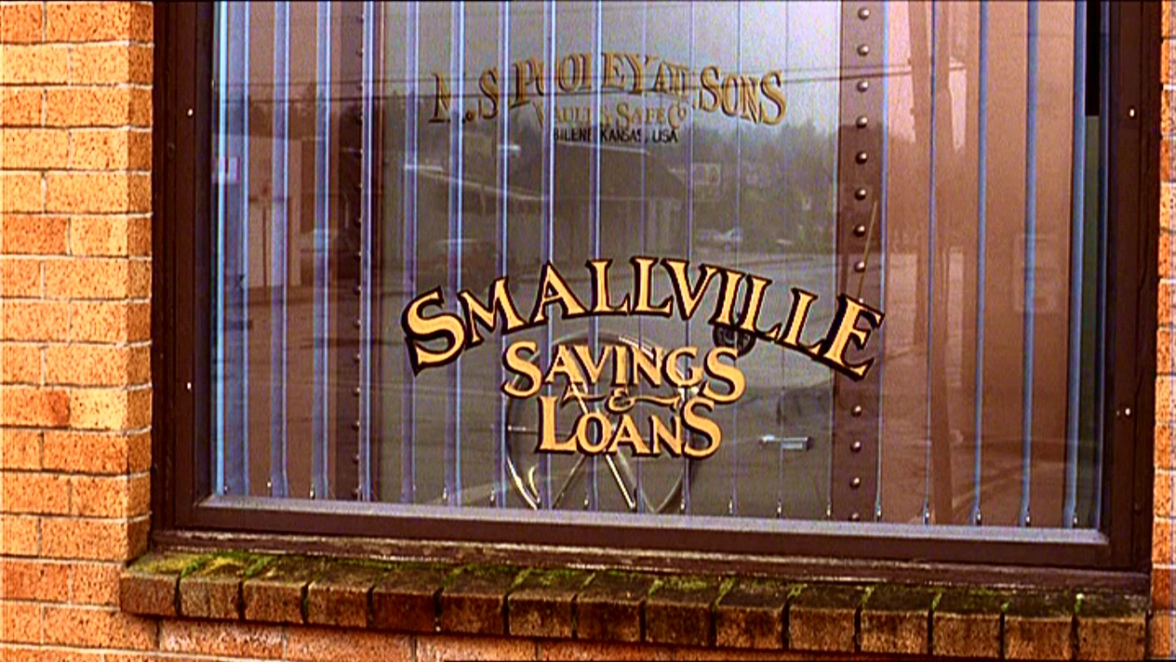
What are 5 types of financial institutions?
Commercial Banks
Savings and loan associations
Mutual savings banks
Credit Unions
Finance Companies

Slide 6
What’s the difference between simple and compound interest?
Simple Interest-
Interest paid only on principal.
If you deposit $100 in a savings account at 5% interest, you will make $5 in a year.
Compound Interest –
Interest paid on both principal and accumulated interest.
If you leave your money in for 2 years, you will be paid interest on your $105, not just the $100.

Slide 7
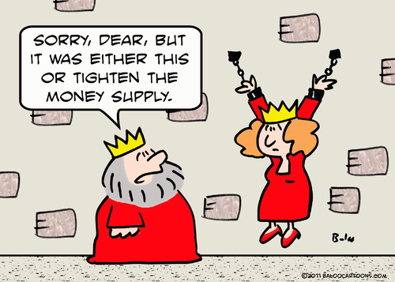
The money supply of a country is made up of what?
Money supply –
All the money available in the country’s economy
All of the M1 and M2 money combined

Slide 8
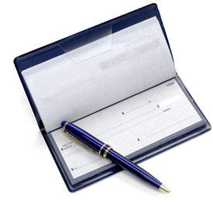
Why are funds in checking accounts called demand deposits?
Demand Deposits –
Money in checking account
Called this because checks can be paid “on demand”, that is, at any time.
Not such a big deal anymore because of debit cards

Slide 9
What is a Credit Union?
Credit Unions are cooperative lending associations for particular groups, usually employees of a specific firm or agency.
Usually specialize in home mortgages or car loans

Slide 10
How does a bank make most of its profit on its business

